Slide 1
LU Factorization with pivoting

Slide 3
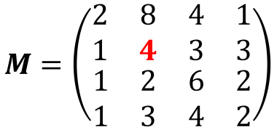
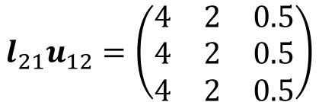
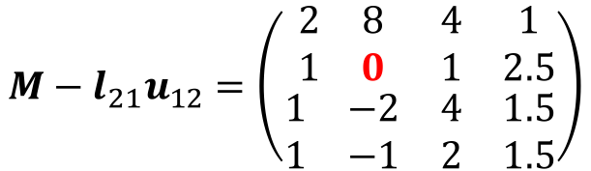
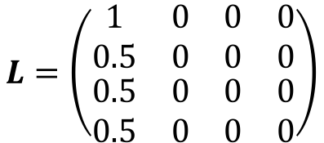
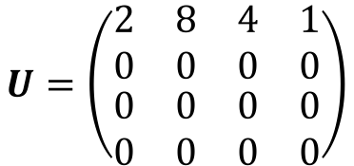
What can go wrong with the previous algorithm for LU factorization?
$$M=\left(\begin{matrix}\begin{matrix}2 & 8 \\ 1 & 4\end{matrix} & \begin{matrix}4 & 1 \\ 3 & 3\end{matrix} \\ \begin{matrix}1 & 2 \\ 1 & 3\end{matrix} & \begin{matrix}6 & 2 \\ 4 & 2\end{matrix}\end{matrix}\right)$$
$$L=\left(\begin{matrix}\begin{matrix}1 & 0 \\ 0.5 & 0\end{matrix} & \begin{matrix}0 & 0 \\ 0 & 0\end{matrix} \\ \begin{matrix}0.5 & 0 \\ 0.5 & 0\end{matrix} & \begin{matrix}0 & 0 \\ 0 & 0\end{matrix}\end{matrix}\right)$$
$$U=\left(\begin{matrix}\begin{matrix}2 & 8 \\ 0 & 0\end{matrix} & \begin{matrix}4 & 1 \\ 0 & 0\end{matrix} \\ \begin{matrix}0 & 0 \\ 0 & 0\end{matrix} & \begin{matrix}0 & 0 \\ 0 & 0\end{matrix}\end{matrix}\right)$$
$$l_{21}u_{12}=\left(\begin{matrix}4 & 2 & 0.5 \\ 4 & 2 & 0.5 \\ 4 & 2 & 0.5\end{matrix}\right)$$
$$M−l_{21}u_{12}=\left(\begin{matrix}\begin{matrix}2 & 8 \\ 1 & 0\end{matrix} & \begin{matrix}4 & 1 \\ 1 & 2.5\end{matrix} \\ \begin{matrix}1 & −2 \\ 1 & −1\end{matrix} & \begin{matrix}4 & 1.5 \\ 2 & 1.5\end{matrix}\end{matrix}\right)$$
The next update for the lower triangular matrix will result in a division by zero! LU factorization fails.
What can we do to get something like an LU factorization?
Notes:
Start of Thursday class?

Slide 4
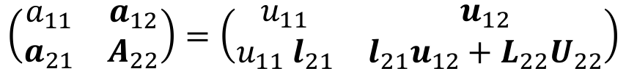
Pivoting
Approach:
Swap rows if there is a zero entry in the diagonal
Even better idea: Find the largest entry (by absolute value) and swap it to the top row.
The entry we divide by is called the pivot.
Swapping rows to get a bigger pivot is called (partial) pivoting.
$$\left(\begin{matrix}a_{11} & a_{12} \\ a_{21} & A_{22}\end{matrix}\right)=\left(\begin{matrix}u_{11} & u_{12} \\ {u_{11} l}_{21} & {l_{21}u_{12}+L}_{22}U_{22}\end{matrix}\right)$$
Find the largest entry (in magnitude)
Notes:
Start of Thursday class?

Slide 5
Sparse Systems

Slide 6
Sparse Matrices
Some type of matrices contain many zeros. Storing all those zero entries is wasteful!
How can we efficiently store large matrices without storing tons of zeros?
Sparse matrices (vague definition): matrix with few non-zero entries.
For practical purposes: an $m×n$matrix is sparse if it has $O\left(\min\left(m,n\right)\right)$ non-zero entries.
This means roughly a constant number of non-zero entries per row and column.
Another definition: “matrices that allow special techniques to take advantage of the large number of zero elements” (J. Wilkinson)

Slide 7
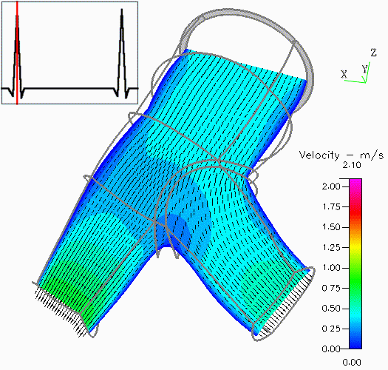
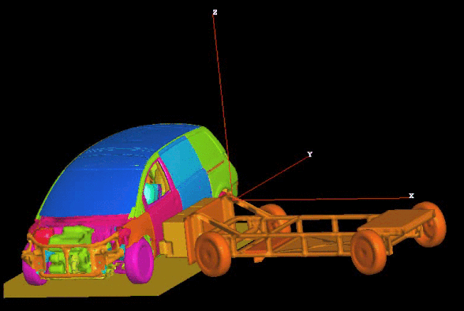
Sparse Matrices: Goals
Perform standard matrix computations economically, i.e., without storing the zeros of the matrix.
For typical Finite Element and Finite Difference matrices, the number of non-zero entries is $O\left(n\right)$

Slide 8
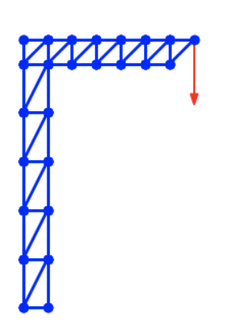
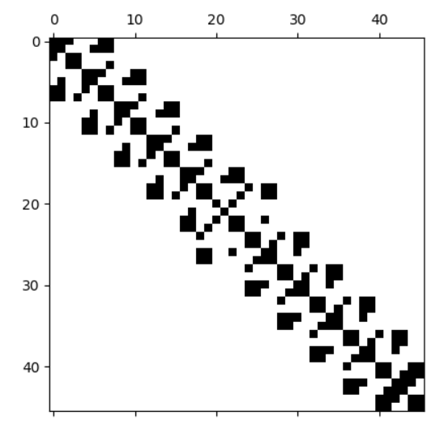
Sparse Matrices: MP example

Slide 9
Sparse Matrices
EXAMPLE:
Number of operations required to add two square dense matrices:
$O\left(n^{2}\right)$
Number of operations required to add two sparse matrices $A$and $B:$
$$O\left(nnz\left(A\right)+nnz(B)\right)$$
where $nnz\left(X\right)=$number of non-zero elements of a matrix $X$

Slide 10
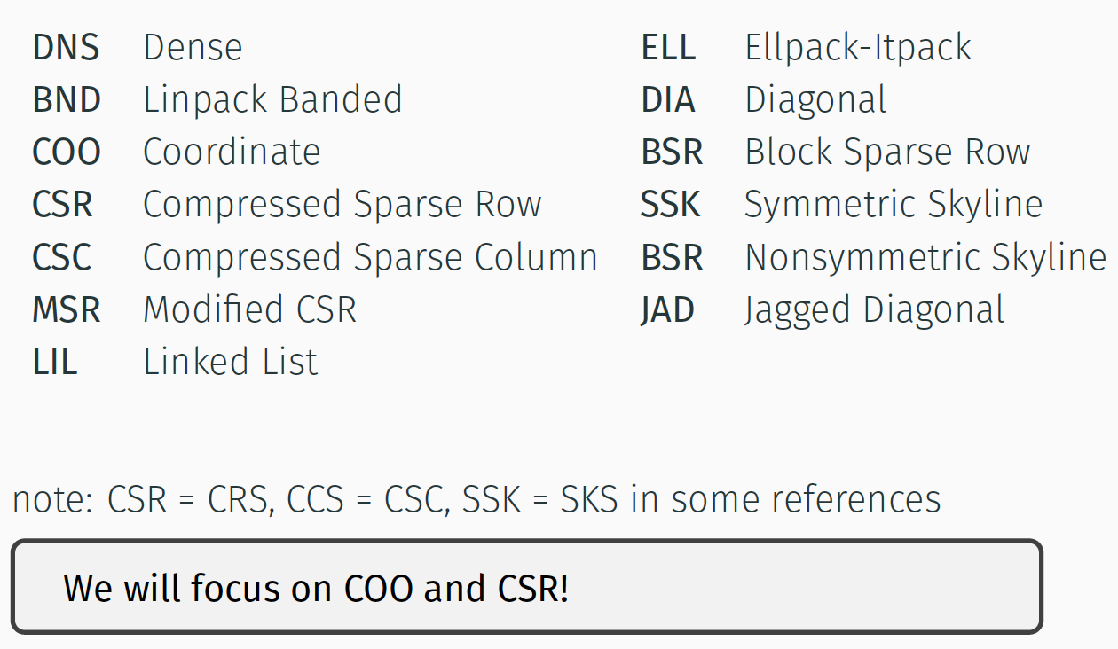
Popular Storage Structures

Slide 11
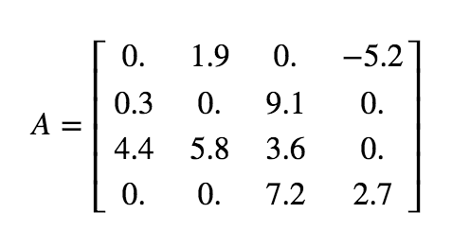
Dense (DNS)
$$Ashape=(nrow,ncol)$$
Row 0
Row 1
Row 2
Row 3
Simple
Row-wise
Easy blocked formats
Stores all the zeros

Slide 12
Coordinate Form (COO)
Simple
Does not store the zero elements
Not sorted
row and col: array of integers
data: array of doubles

Slide 13
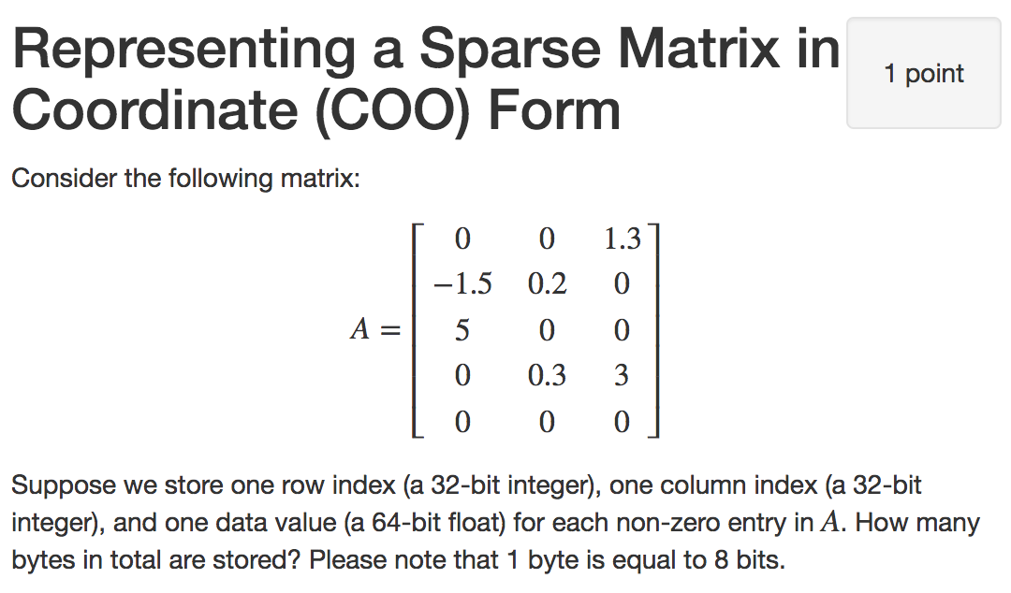

Slide 14
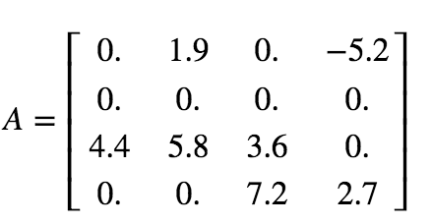
Compressed Sparse Row (CSR) format
Notes:
3

Slide 15
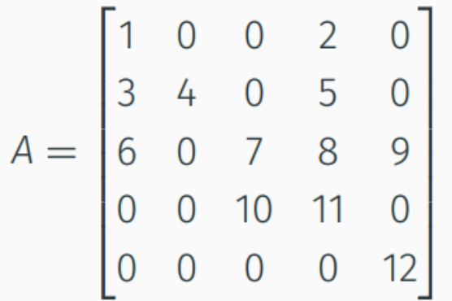
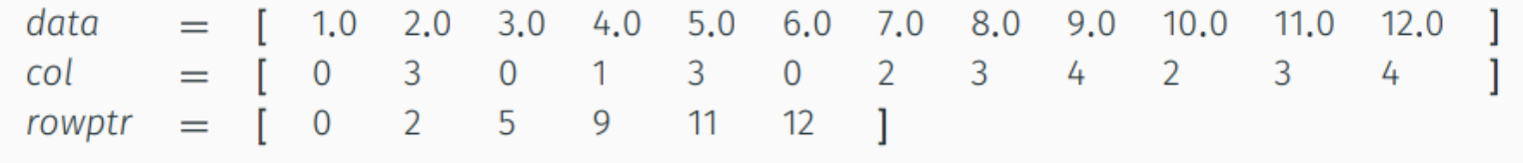
Compressed Sparse Row (CSR)
Does not store the zero elements
Fast arithmetic operations between sparse matrices, and fast matrix-vector product
col: contain the column indices (array of $nnz$integers)
data: contain the non-zero elements (array of $nnz$doubles)
rowptr: contain the row offset (array of $n+1$integers)

